Slide 1

BLACK SPADE
PRESENTS

Slide 2

team members
ROOPA K
[RA2311003011842]
P HEMANTH KUMAR
[RA2311003011873]
ANDREW REBELLO L
[RA2311003011831]
DEPARTMENT: C TECH

Slide 3

ABOUT US
welcome
We are young minds, filled with limitless dreams, embarking on a journey with our startup, “Paddle Your Energy”. Every pulse of our passion transforms vibrations into unstoppable energy, driving us forward to create a powerful future
01

Slide 4

PROBLEM
STATEMENT
The abundance of charging ports, numerous extension boxes,
and excessive wires create a cluttered and disorganized environment
This tangled mess not only makes things more complex but also leads to inefficiency and frustration when managing devices.
The current setup is unsustainable and calls for a simplified, streamlined solution.
02

Slide 5

IDEA
Reduce the clutter of cords and unleash your own energy right where you sit. With each tap of your feet, you create electricity, instantly powering your devices. This innovative solution transforms simple actions into a boundless source of sustainable energy.
INTRODUCING
our IDEA
03

Slide 6
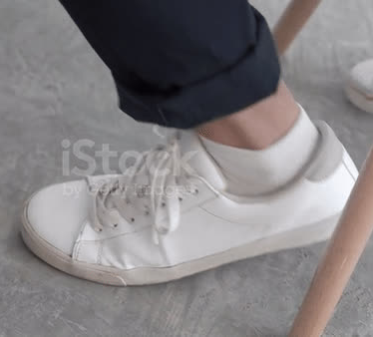
In our project, we aim to harness your everyday habits to address your energy needs. Many people tend to tap their feet when they are anxious or deep in thought. We convert the vibrational energy generated from this tapping into electrical energy, which can then be used to charge your devices.
04

Slide 7
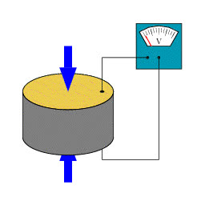
WORKING
We’ll use piezoelectric generators to turn everyday vibrations, like foot-tapping or movement, into electrical energy. These generators work by using special materials that produce electricity when they are stressed or vibrated. This electricity is then collected and used to charge your devices or stored for later.
08

Slide 8
LET’S CALCULATE
VOLTAGE
THE VOLTAGE GENERATED DEPENDS ON THE MECHANICAL STRESS APPLIED AND THE PIEZOELECTRIC MATERIAL’S PROPERTIES. FOR A GIVEN MECHANICAL STRESS, THE VOLTAGE CAN BE APPROXIMATED BY:
V=G⋅F
WHERE:
G IS THE PIEZOELECTRIC VOLTAGE COEFFICIENT
F IS THE FORCE APPLIED TO THE PIEZOELECTRIC MATERIAL

Slide 9

Target Audience
Our target audience currently includes students and employees. However, we have the potential to expand our reach by also incorporating gyms, dance classes, yoga classes, and similar activities into our offerings. This approach will allow us to cater to a broader range of interests and needs, thereby extending our boundaries and attracting a more diverse audience.

Slide 10
FEASIBILITY AND SCALABILITY
Feasibility
Technology Viability:
User Adoption:
Prototype Development:
Scalability
Market Growth Potential
Integration with Existing Infrastructure:
Target Audience Expansion

Slide 11

IMPACT
Introducing a novel way of generating energy through daily habits
The project could lead to more efficient energy use in various settings, from schools and offices to gyms and public spaces, potentially reducing overall energy consumption.
The development and scaling of this technology could create new job opportunities in research

Slide 12
ADVANTAGES
Charges Devices Locally
Reduced Dependency
Utilizes Everyday Habits
Habits Turned into Profit
07

Slide 13

Energy Output Depends on the Number of People
DISADVANTAGES
Not Everyone Has the Habit
Short-Term Energy Storage
06

Slide 14
a
Thank You
BLACK SPADE

